Slide 1
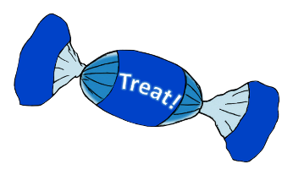
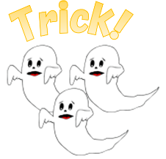
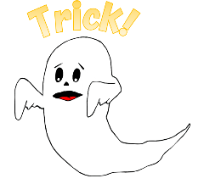
1
2
3
4
5
6
7
8
9
10
11
12
13
14
15
16
17
18
19
20
tekhnologic
Notes:
1 Ghost – 6, 9. 15, 16
3 Ghosts – 2, 13

Slide 2
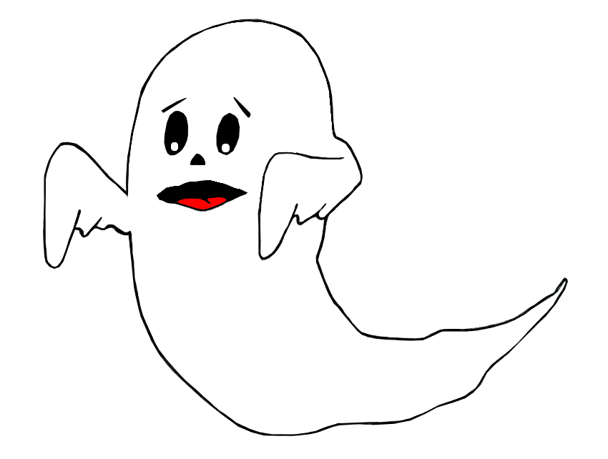
Trick!
Lose half your points!

Slide 3
Trick!
Lose all your points!

Slide 4
Challenge
Name 5 colours

Slide 5
Challenge
Name the days of the week.

Slide 6
Challenge
7:00
What time is it?
Say it in words.

Slide 7
Challenge
Put the sentence in order.
likes – apples – He – and – bananas.

Slide 8
Challenge
Name 5 animals

Slide 9
Challenge
Sing a song in English

Slide 10
Challenge
Name 5 things you can eat.

Slide 11
Find the odd one out
shirt
apple
shoe
dress
tekhnologic
Notes:
A: Correct

Slide 12
Find the odd one out
cat
dog
school
fish
tekhnologic
Notes:
B: Correct

Slide 13
Fill in the correct word.
I …….. bananas
look
make
yellow
like
tekhnologic
Notes:
C: Correct

Slide 14
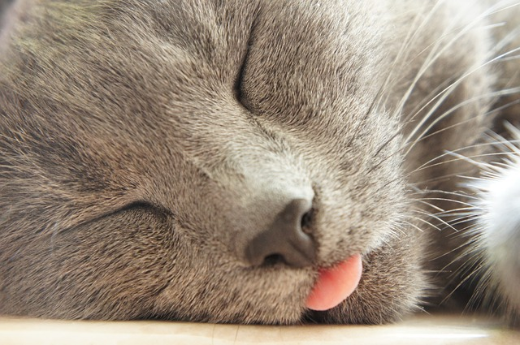
1
2
3
4
5
6
7
8
9
10
11
12
13
14
15
16
17
18

Slide 15
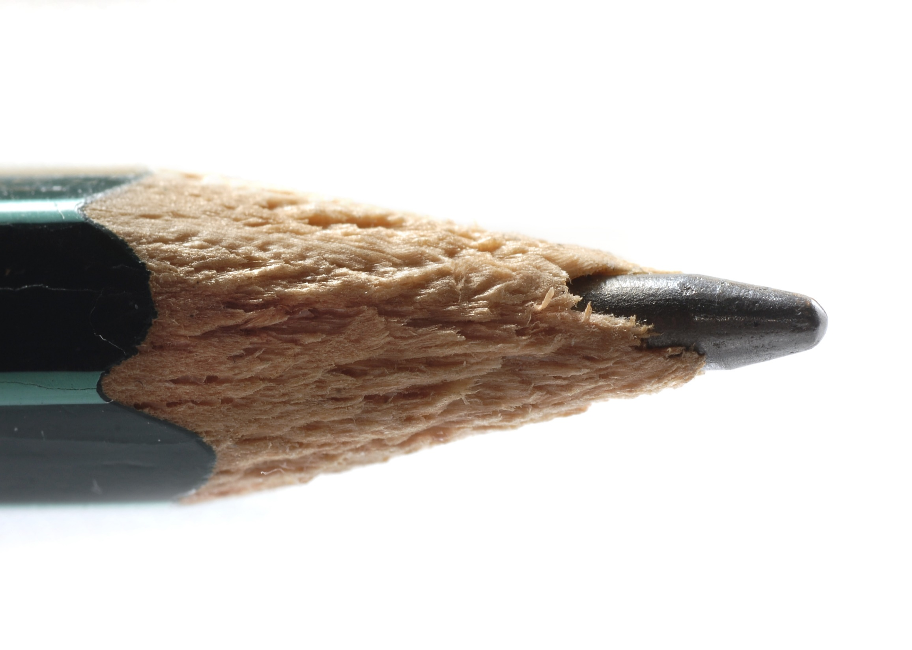
1
2
3
4
5
6
7
8
9
10
11
12
13
14
15
16
17
18

Slide 16
1
2
3
4
5
6
7
8
9
10
11
12
13
14
15
16
17
18

Slide 17
Challenge
Put the sentence in order.
football - you – Do – playing – like – ?

