Slide 1
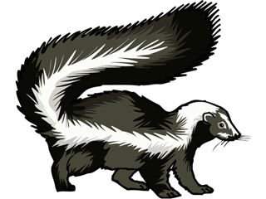
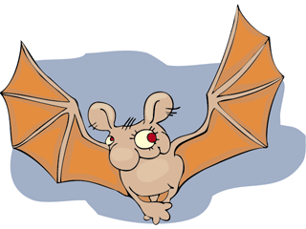
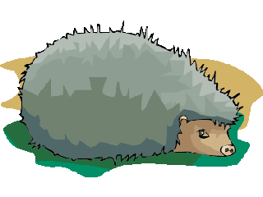
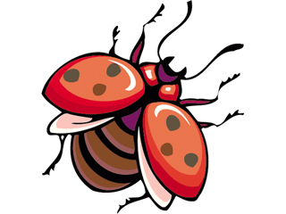
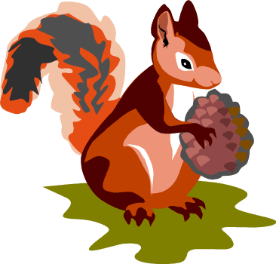
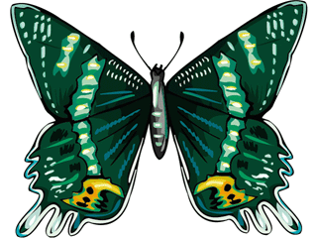
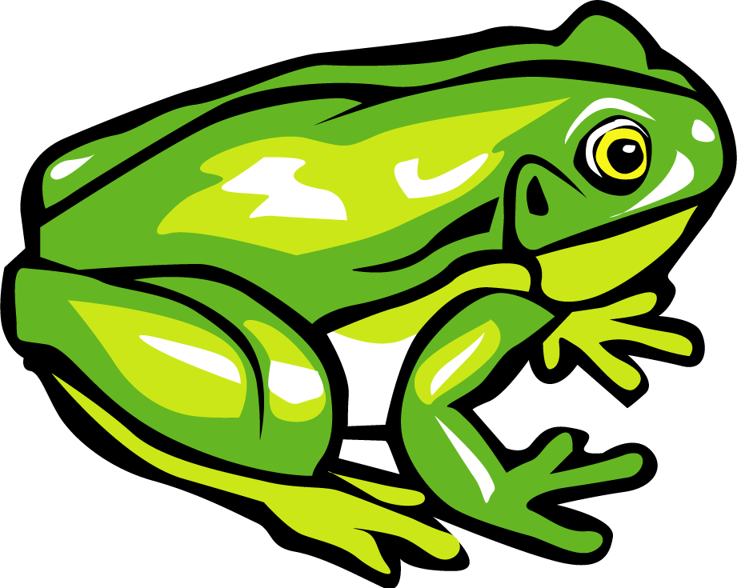
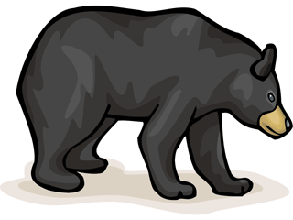
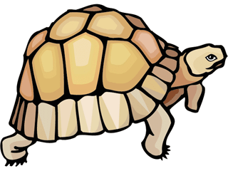
Hibernating Animals

Slide 2
A hedgehog
What am I?

Slide 3
A bat
What am I?

Slide 4
A wasp
What am I?

Slide 5
A squirrel
What am I?

Slide 6
A badger
What am I?

Slide 7
A bear
What am I?

Slide 8
A butterfly
What am I?

Slide 9
A frog
What am I?

Slide 10
A turtle
What am I?

Slide 11
A skunk
What am I?

Slide 12
A ladybird
What am I?
images © Graphics Factory.com

